Slide 1
Receiver Diversity - Optical Wireless Positioning
Kevin Jose ACUNA CONDORI
08/09/2026

Slide 2
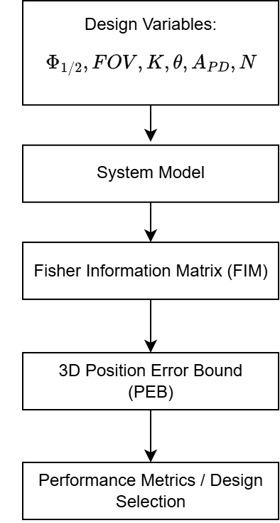
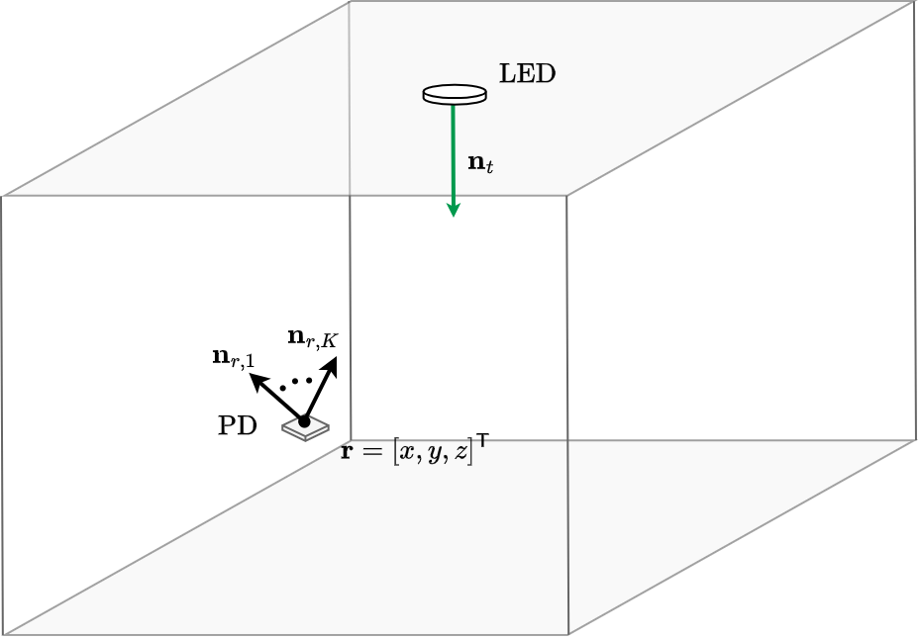
Methodology

Slide 3
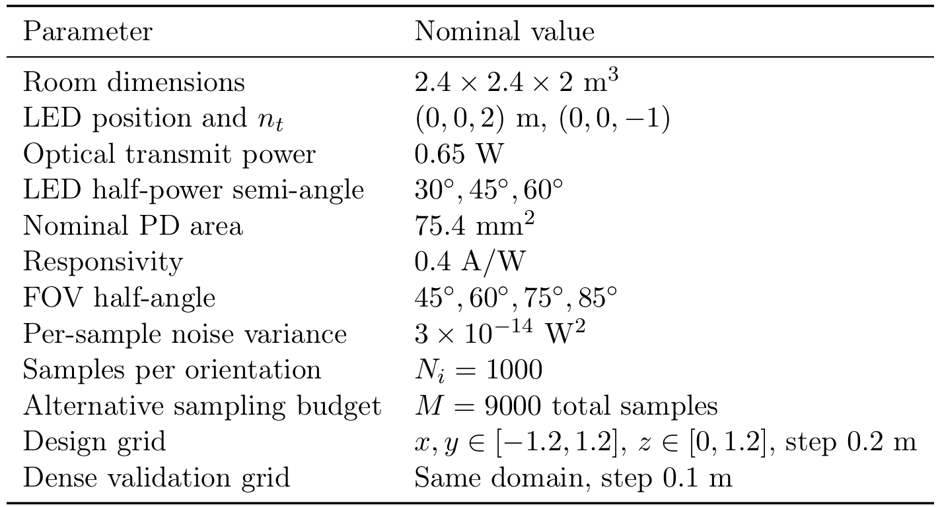

Slide 4
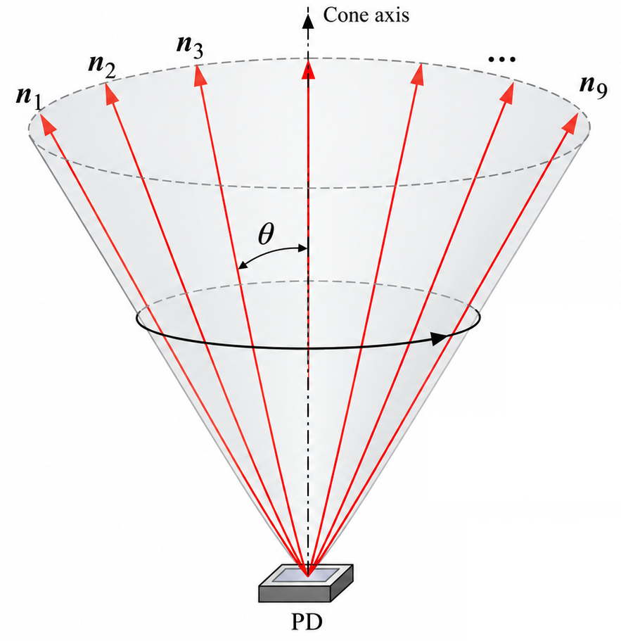
For the following analysis, we consider K PD reorientations with a fixed tilt θ, uniformly spaced in azimuth.

Slide 5
K=9

Slide 6
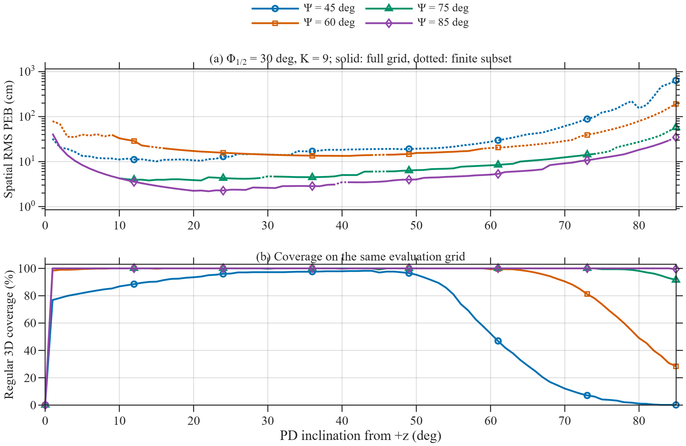
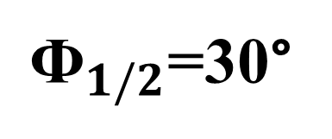
${\text{Ф}}_{1/2}$=30°

Slide 7
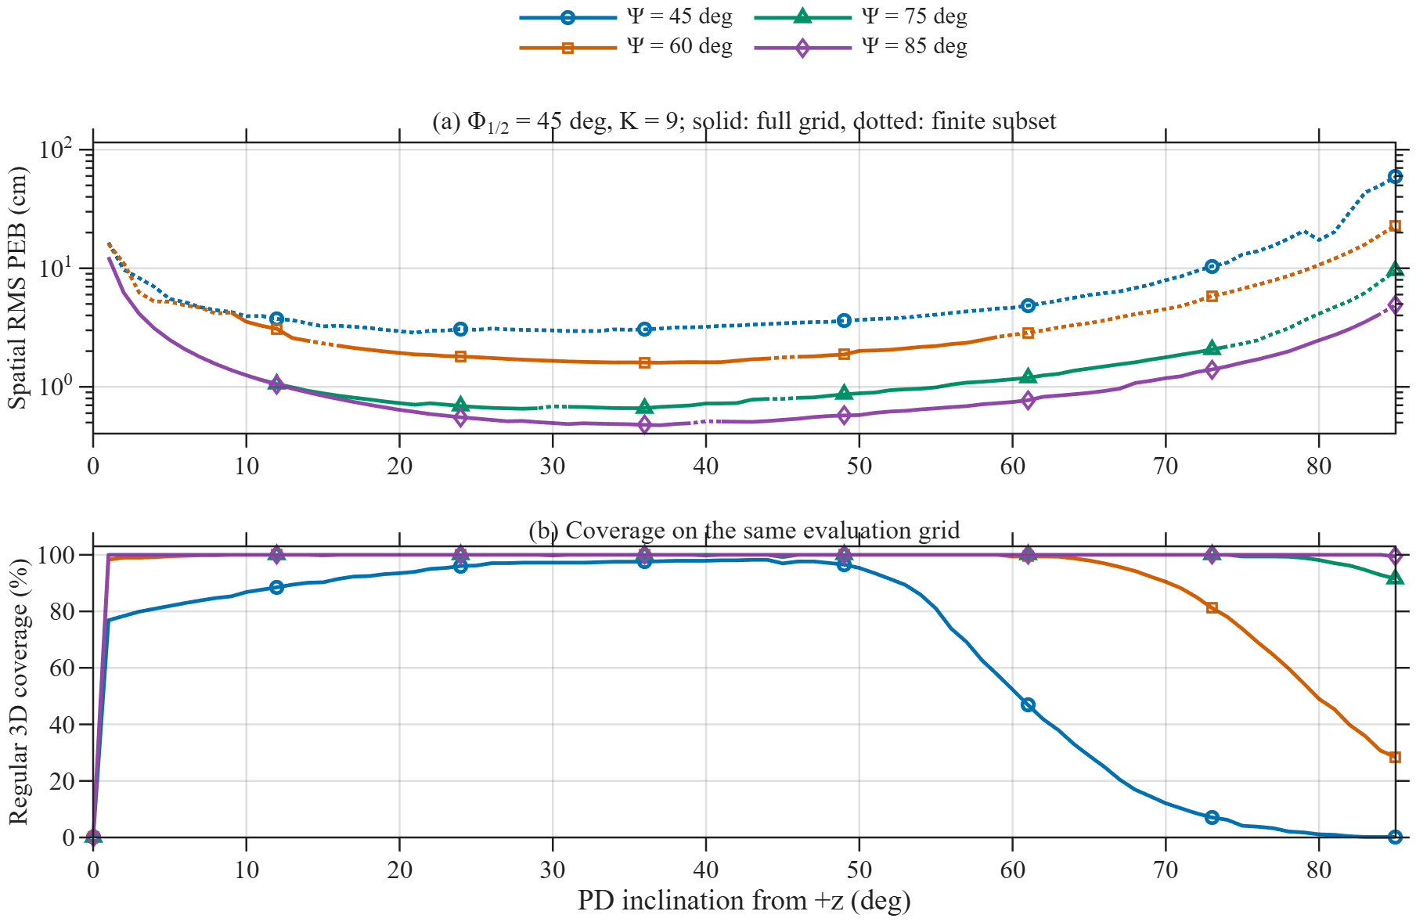
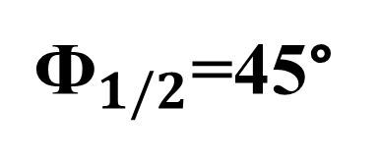
${\text{Ф}}_{1/2}$=45°

Slide 8
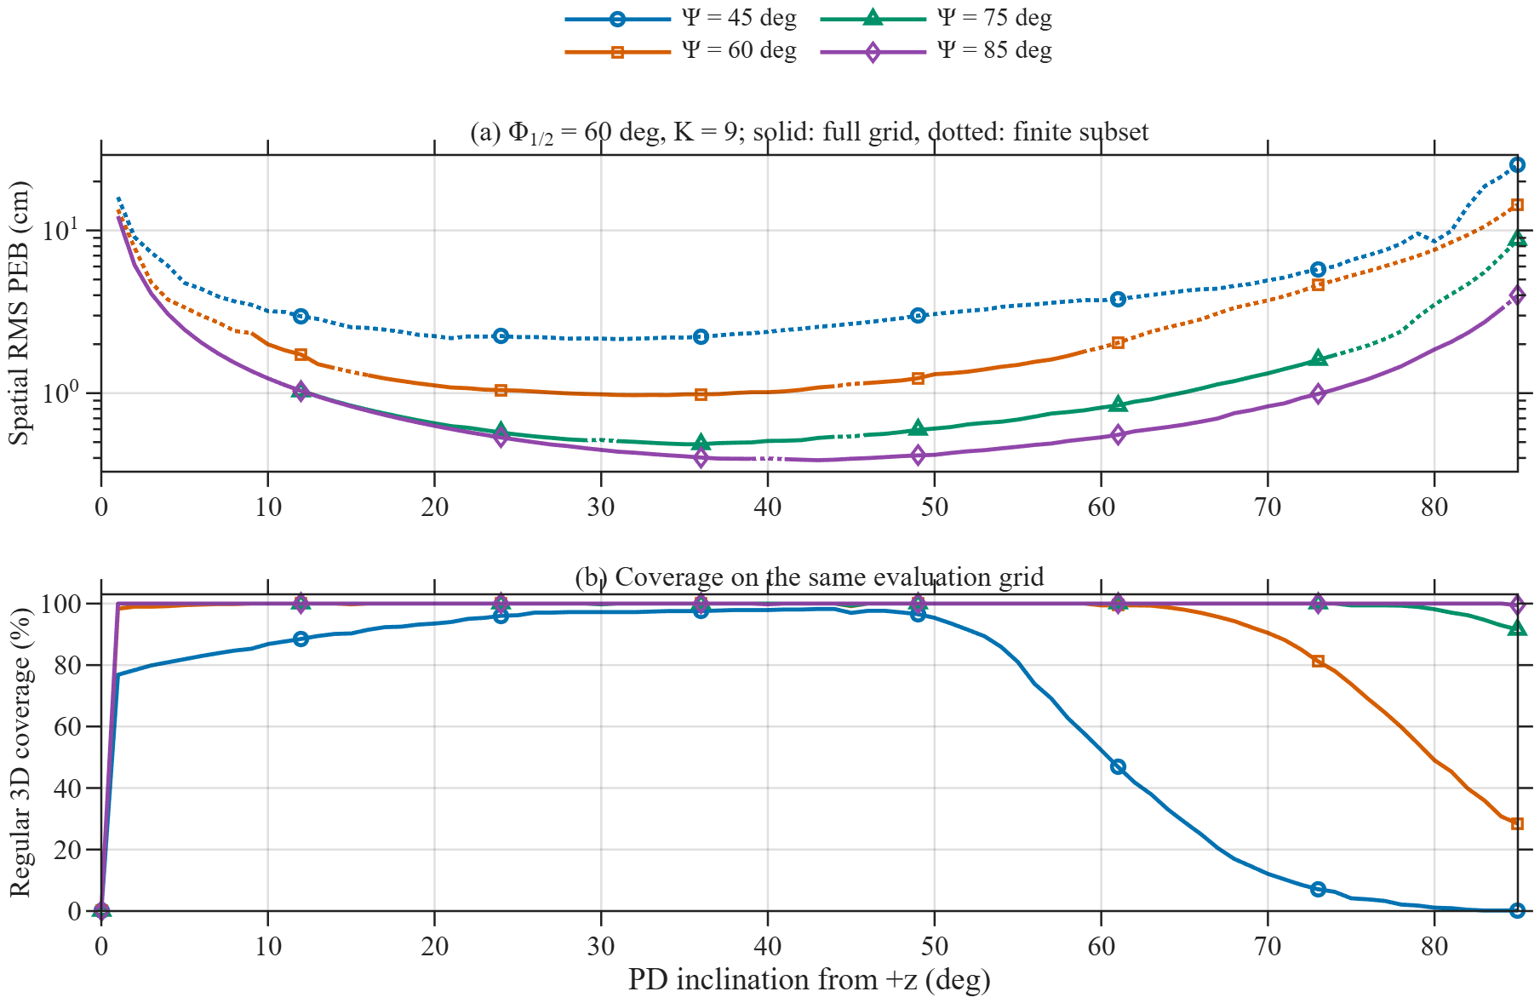
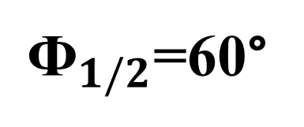
${\text{Ф}}_{1/2}$=60°

Slide 9
K=3
(minimal configuration)

Slide 10
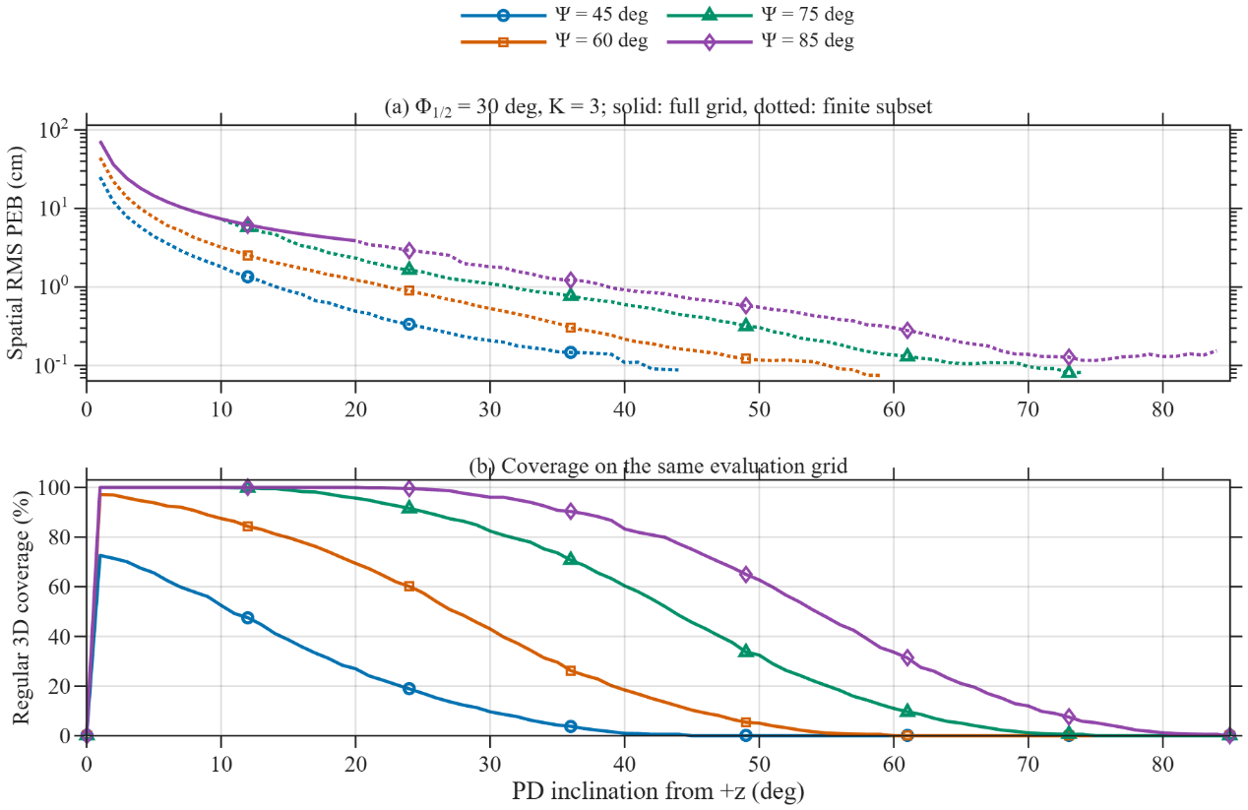
${\text{Ф}}_{1/2}$=30°

Slide 11
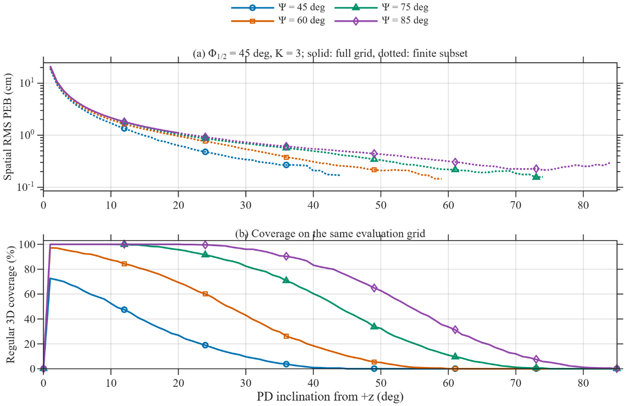
${\text{Ф}}_{1/2}$=45°

Slide 12
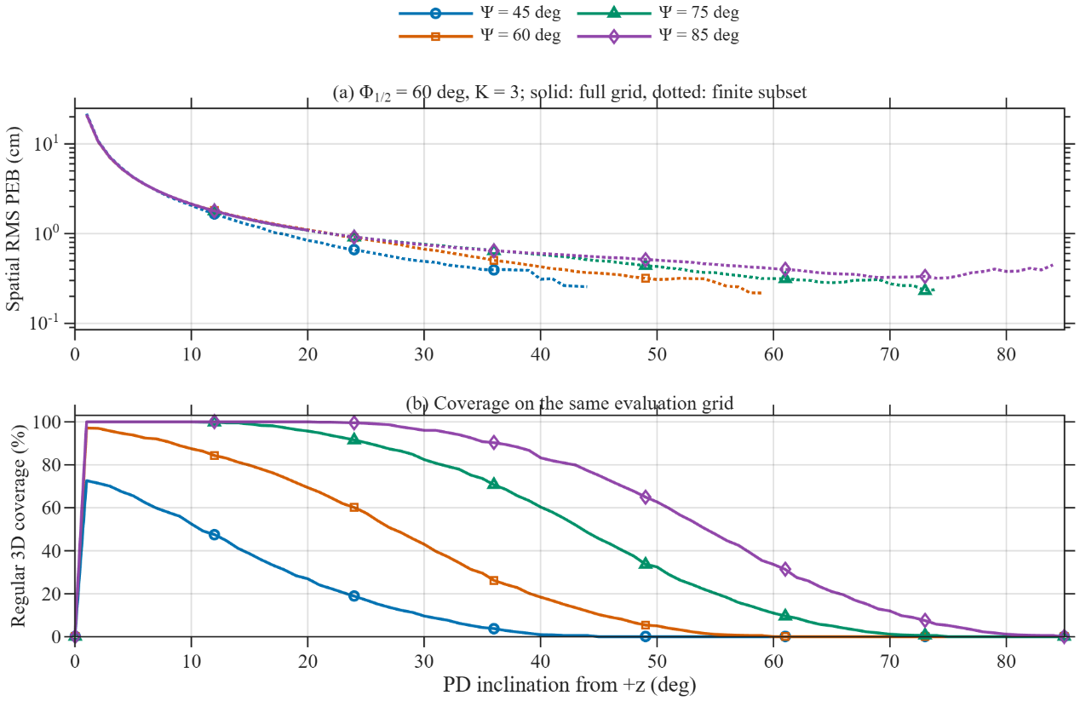
${\text{Ф}}_{1/2}$=60°

Slide 13
Influence of K at different tilt angles θ

Slide 14
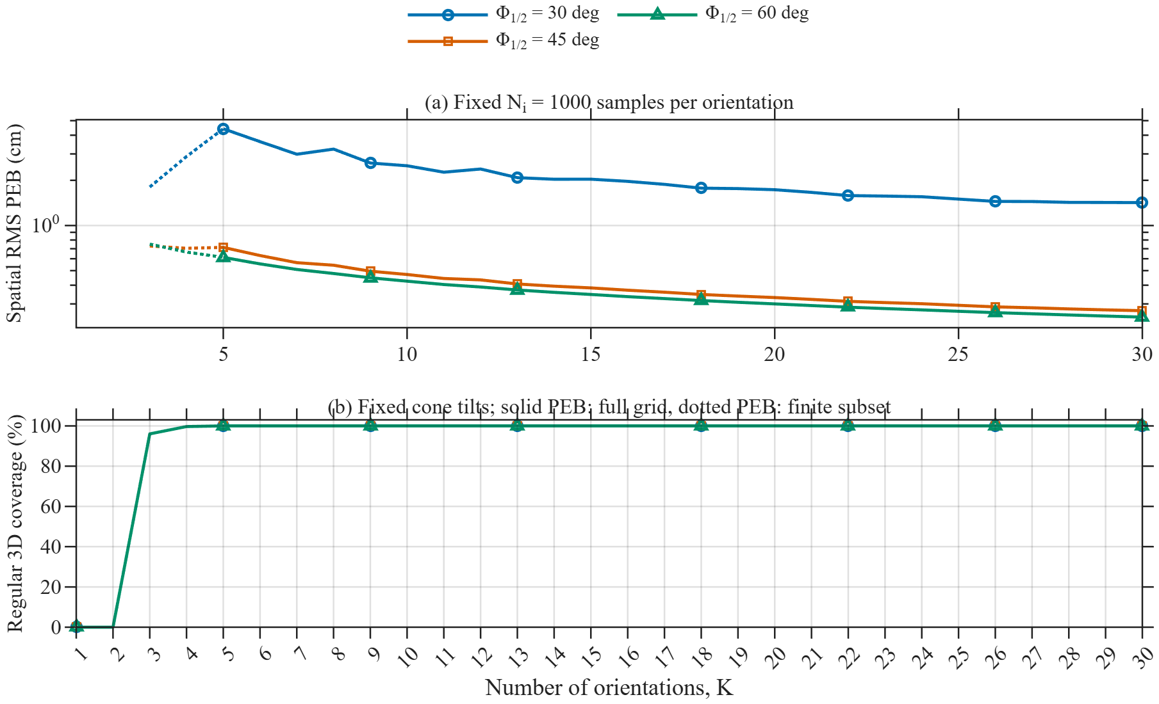
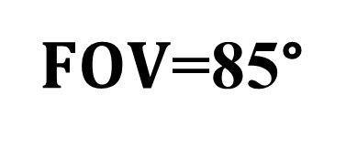
θ=30°
$FOV$=85°

Slide 15
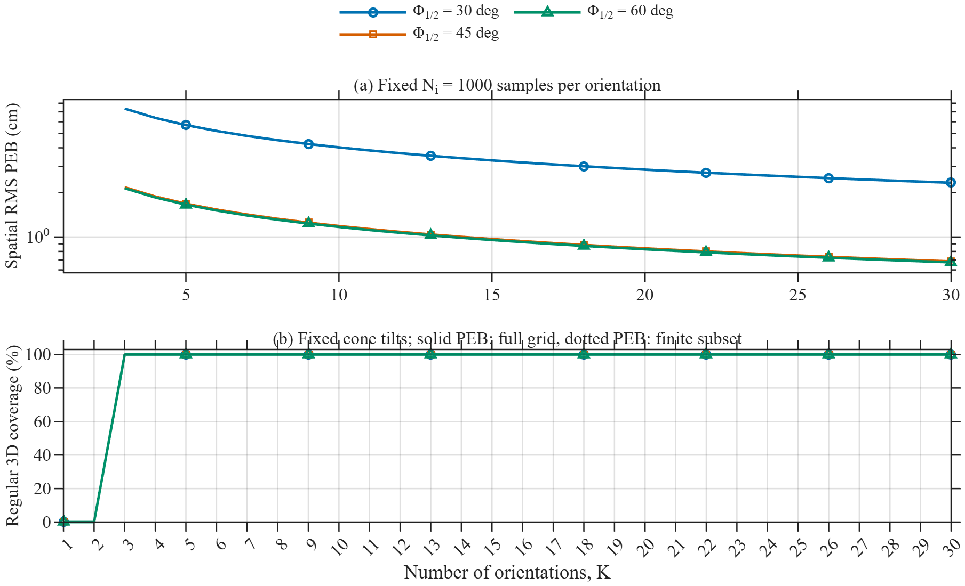
θ=10°
$FOV$=85°

Slide 16
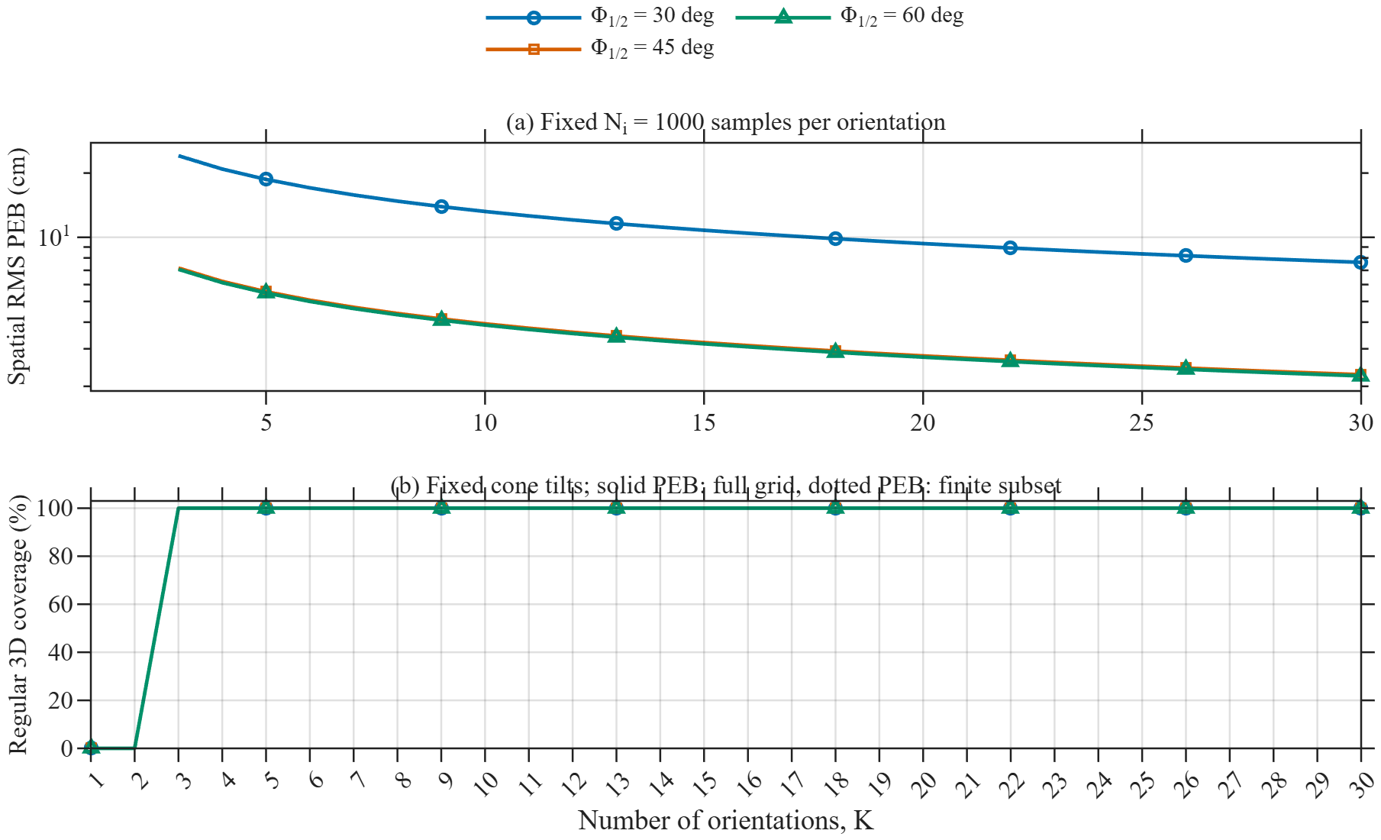
θ=3°
$FOV$=85°

Slide 17
Influence of A_PD

Slide 18
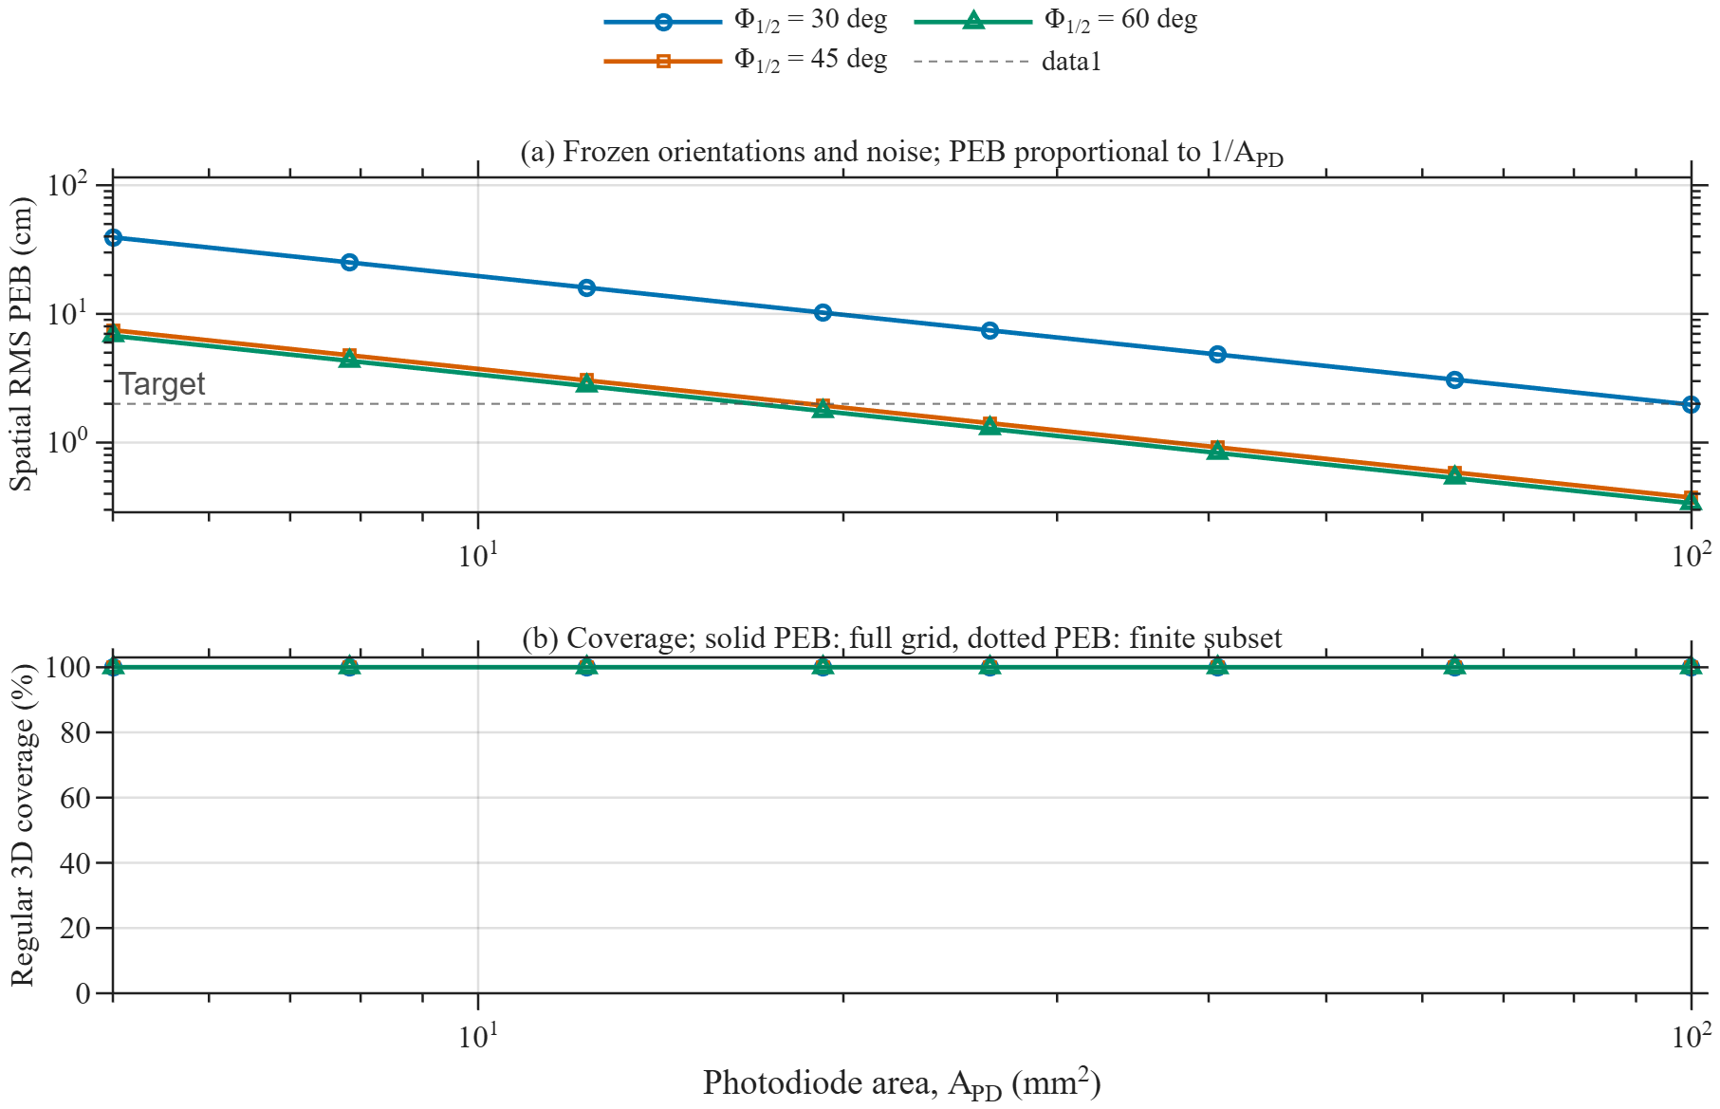
θ=30°, FOV=85, K=9

Slide 19
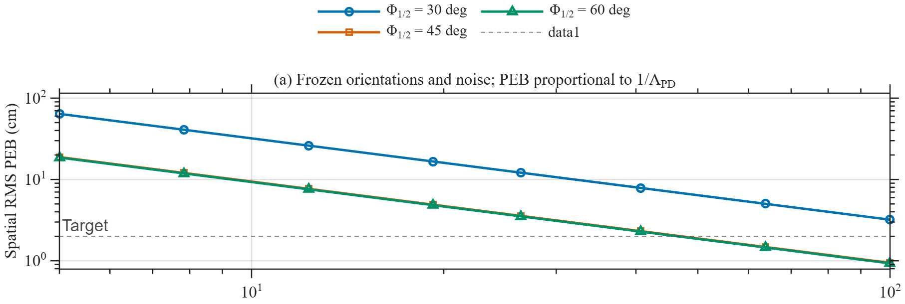
θ=10°, FOV=85, K=9

Slide 20
Heatmap (errors)

Slide 21
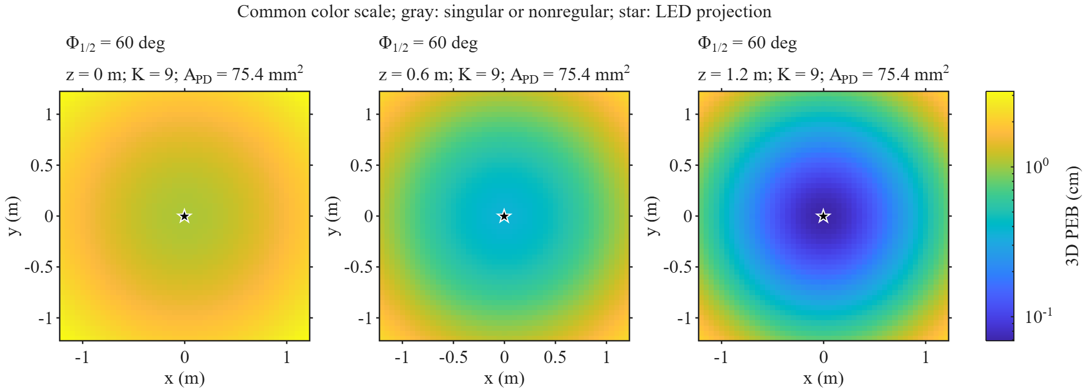
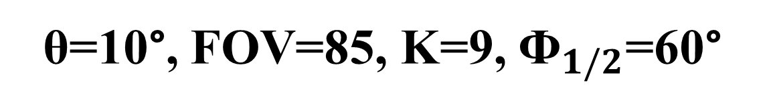
θ=10°, FOV=85, K=9, ${\text{Ф}}_{1/2}$=60°

Slide 22
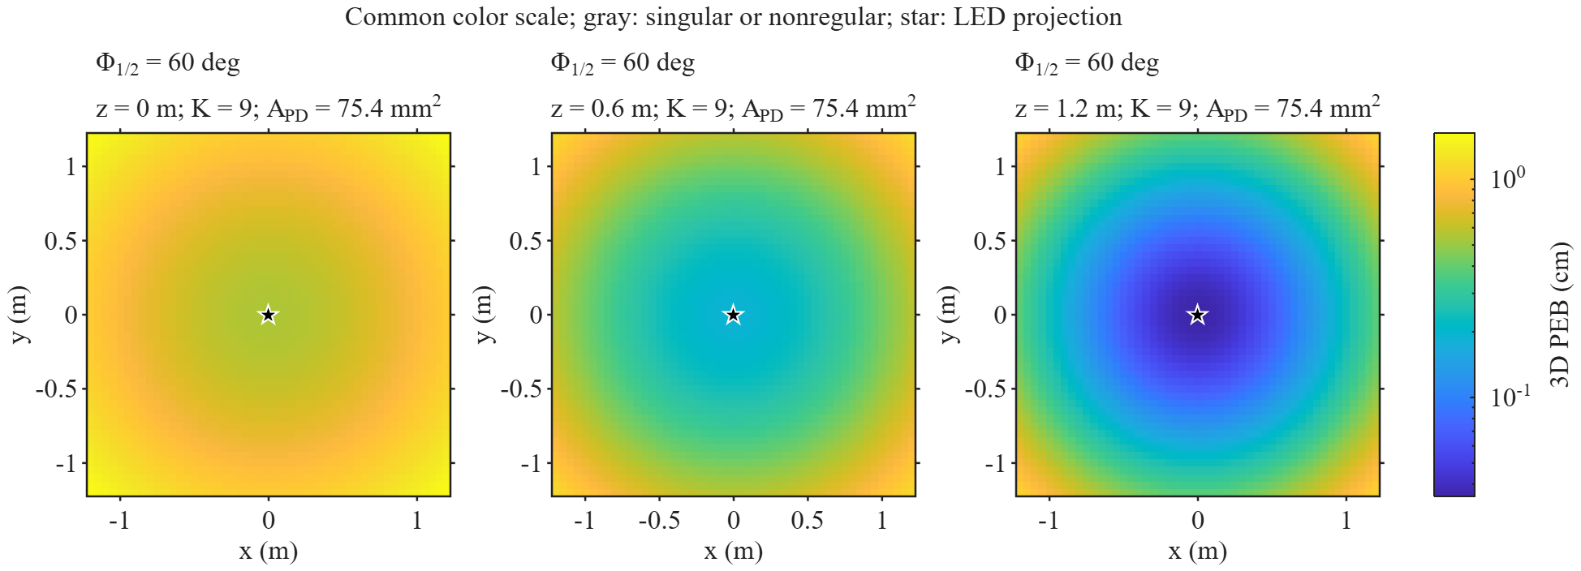
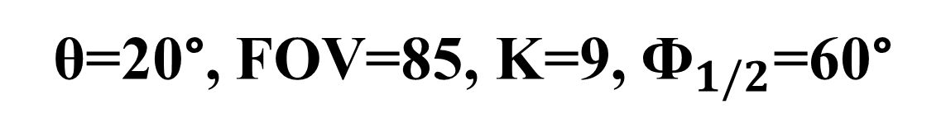
θ=20°, FOV=85, K=9, ${\text{Ф}}_{1/2}$=60°

Slide 23
Coverage

Slide 24
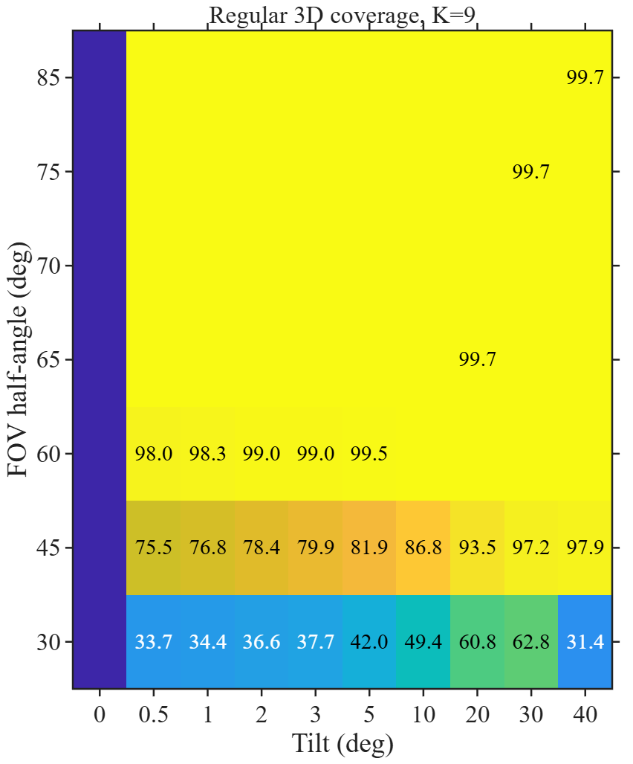
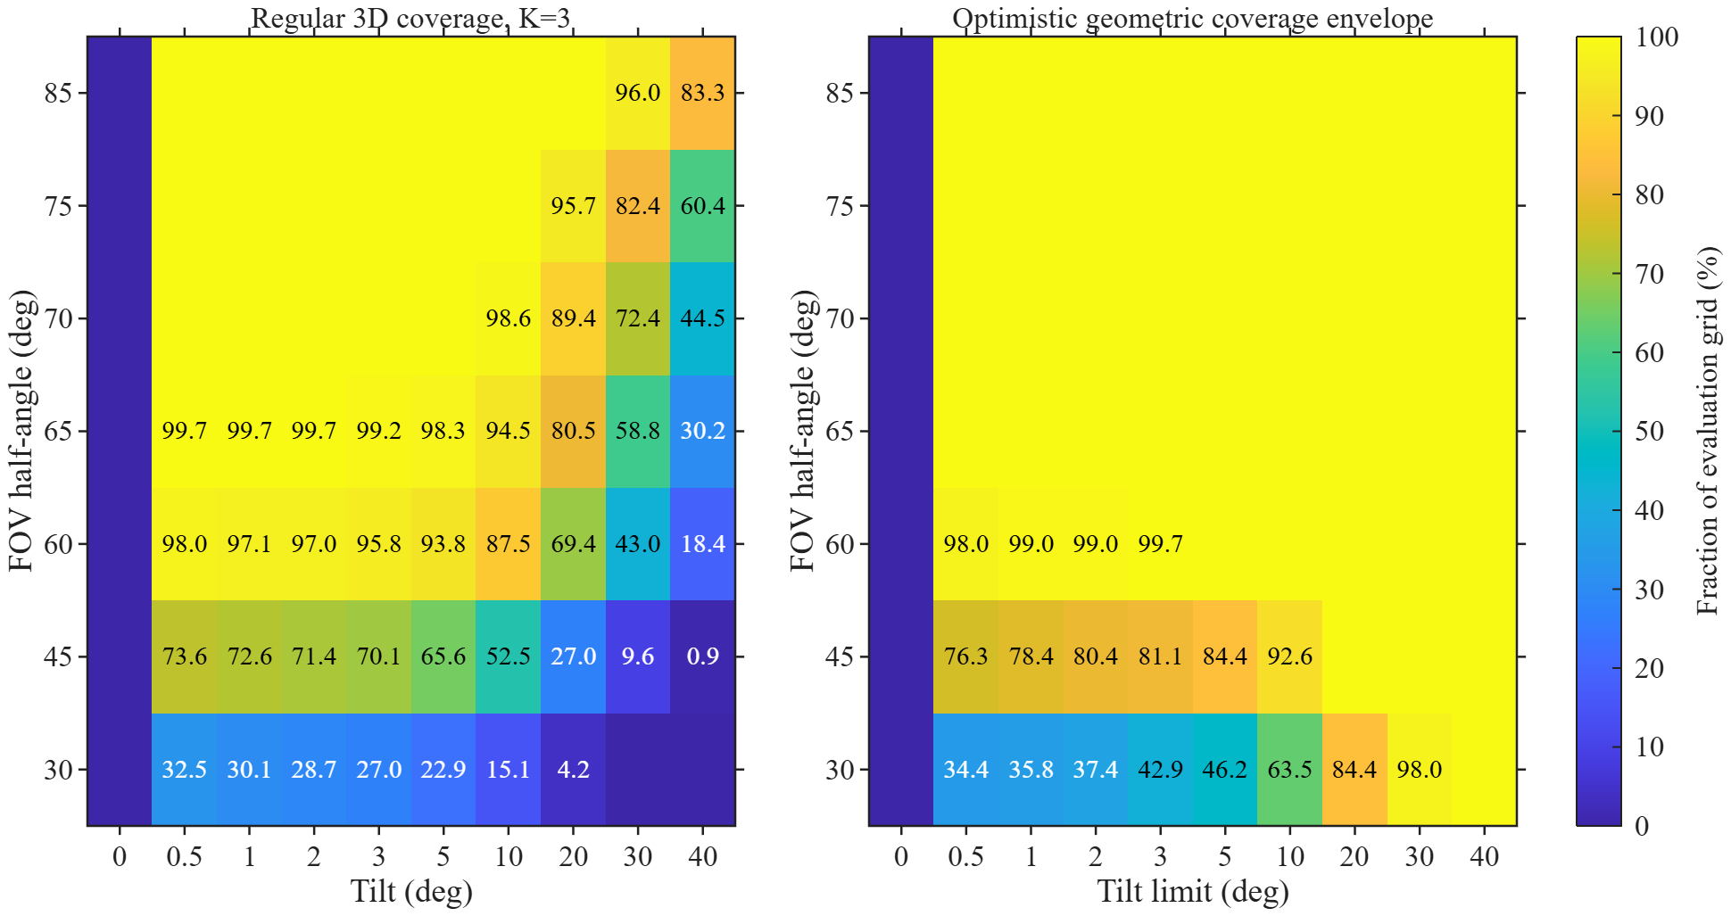


K=9, ${\text{Ф}}_{1/2}$=60°
K=3, ${\text{Ф}}_{1/2}$=60°

Slide 25
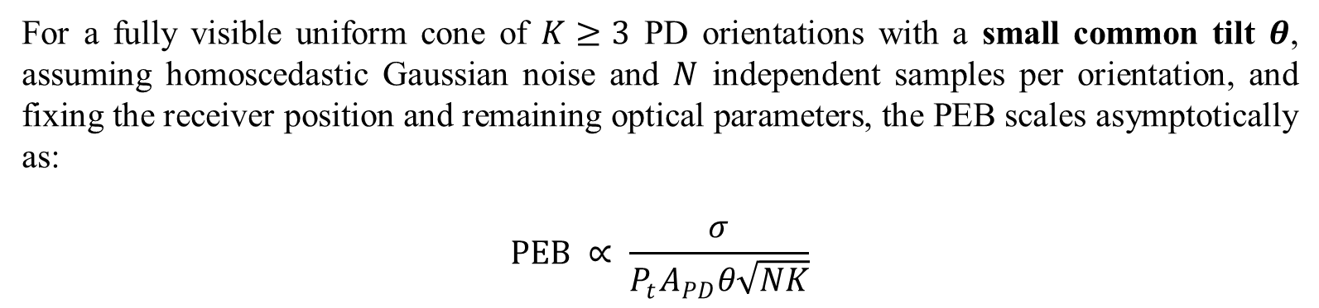
For a fully visible uniform cone of $K≥3$ PD orientations with a small common tilt $θ$, assuming homoscedastic Gaussian noise and $N$ independent samples per orientation, and fixing the receiver position and remaining optical parameters, the PEB scales asymptotically as:
$$PEB ∝ \frac{σ}{P_{t}A_{PD}θ\sqrt{NK}}$$

Slide 26
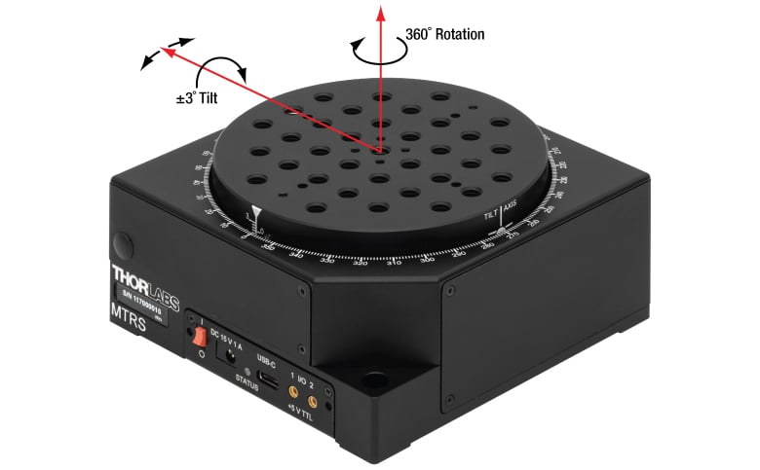
Analysis for small tilt (θ=3°)
MTRS
https://www.thorlabs.com/motorized-tilt-and-rotation-stage-with-integrated-controller

Slide 27
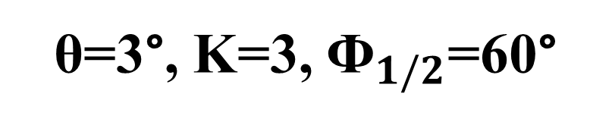
θ=3°, K=3, ${\text{Ф}}_{1/2}$=60°

Slide 28
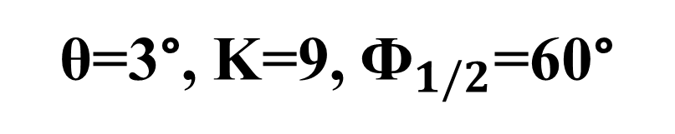
θ=3°, K=9, ${\text{Ф}}_{1/2}$=60°

Slide 29
Conclusiones
Se recomienda un Angulo de potencia media de 45° a 60°.
A menor inclinación se require aumentar la cantidad K de reorientaciones para compensar la Perdida de información.
Se recomienda una inclinación entre 20 y 30°, con un K entre 5 y 9.
Incrementar el Area del PD ayuda a reducer el error.

